Slide 1
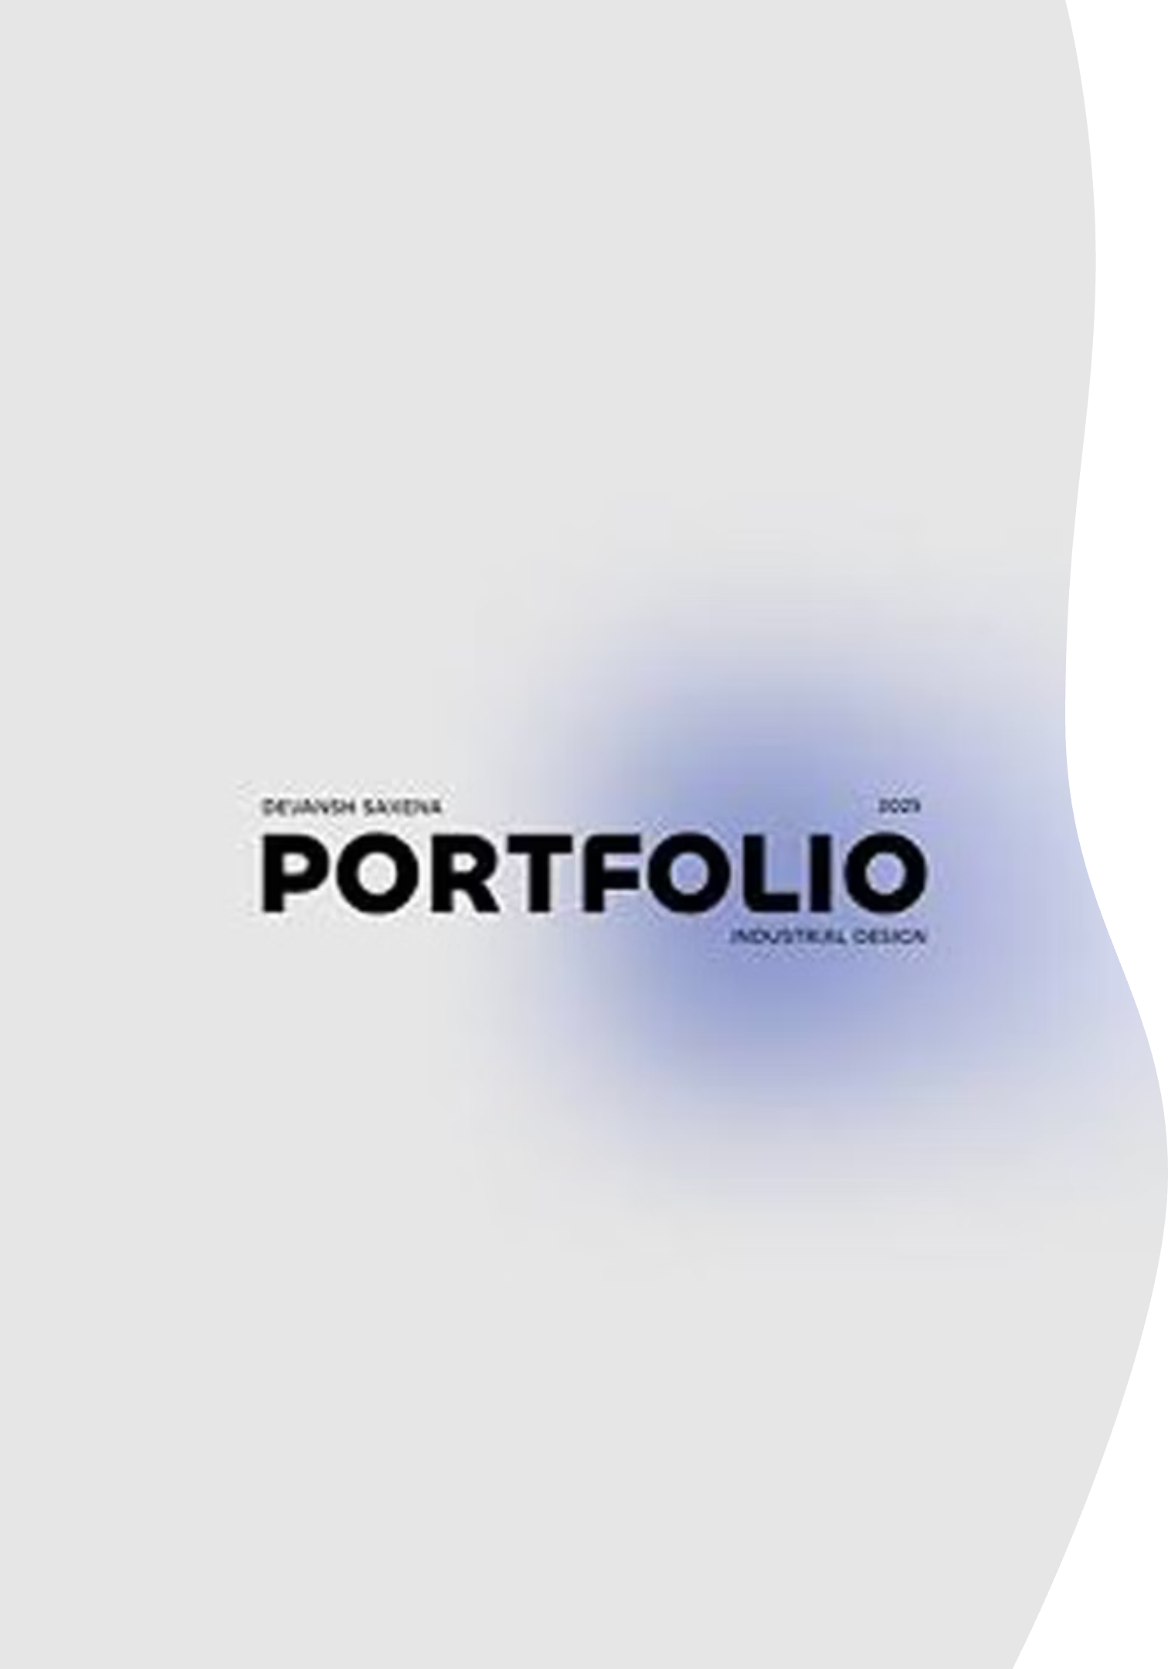
Digital Portfolio
STUDENT NAME: BAGRUDEEN ALI AHAMED JPROJECT TITLE: MODERN PORTFOLIO WEBSITE REGISTER NO AND NMID: B24AE044D4CE7A5B18A47DFD26B5E421 DEPARTMENT: BCA COMPUTER APPLICATION TECHNOLOGY COLLEGE: SRM ARTS AND SCIENCE COLLEGE

Slide 2
Project Overview
This is a modern, responsive portfolio website.
It is built with HTML5, CSS3, and JavaScript.
The website features advanced animations, interactive elements, and a professional design.
The design is suitable for creative professionals, developers, and digital artists.
It serves as a comprehensive guide for modern web development.

Slide 3
Agenda
Problem Statement
1
2
Project Overview
Who are the End Users?
3
4
Tools and Technologies
Portfolio Design and Layout
5
6
Features and Functionality
Results and Screenshots
7
8
Conclusion
Github Link
9

Slide 4
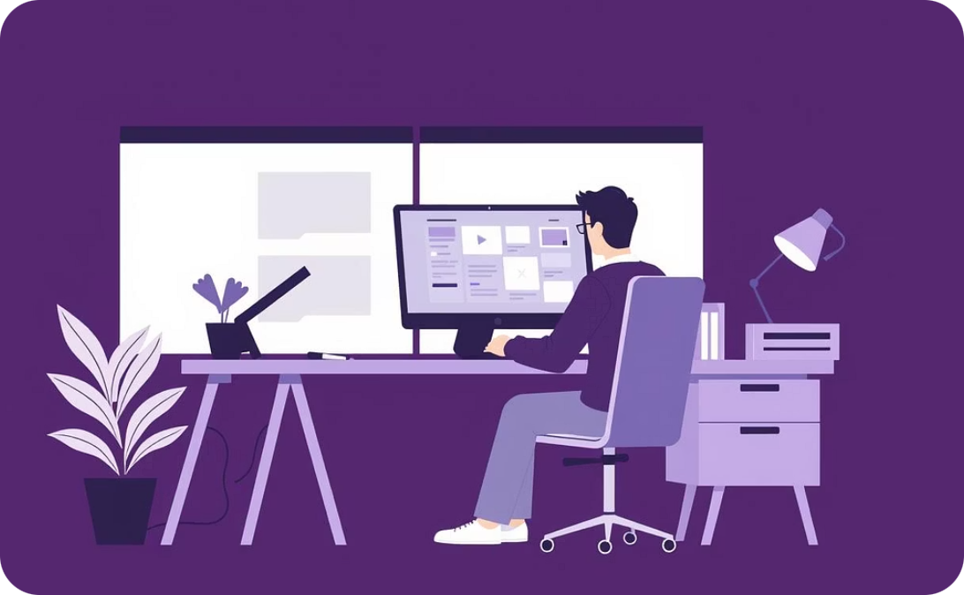
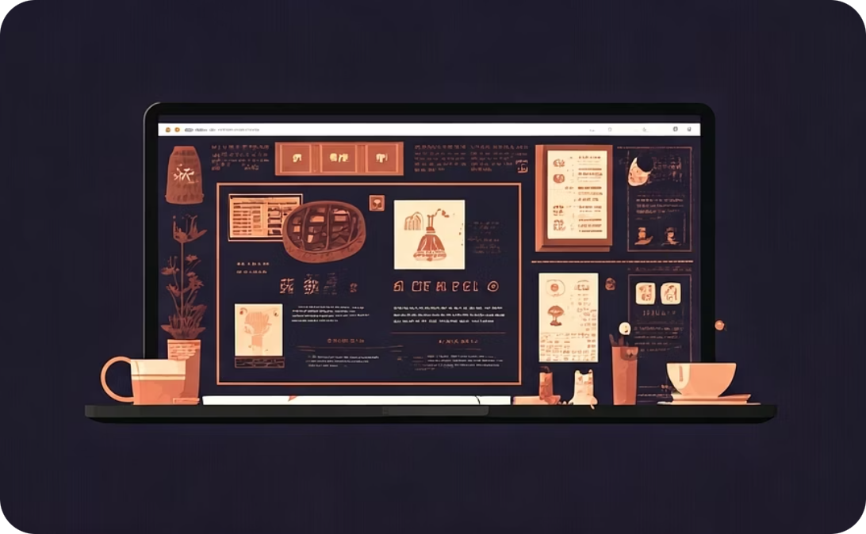
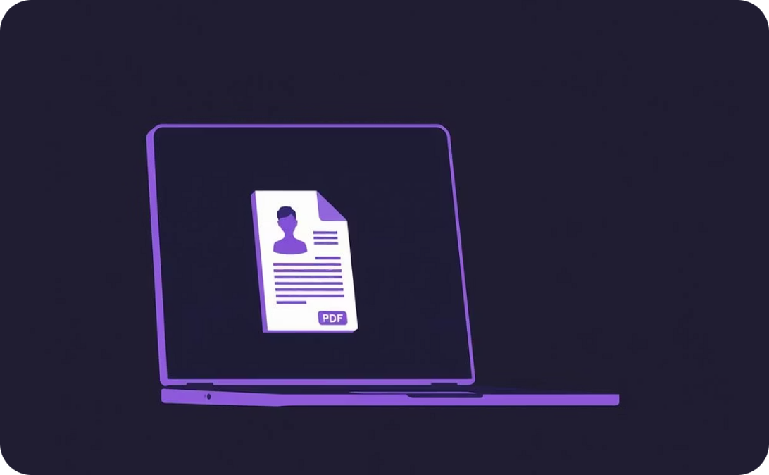
Problem Statement
Online Presence
Showcasing Skills & Projects
Digital Resume
The project addresses the critical need for creative professionals and developers to establish a strong online presence.
It provides an effective solution to showcase skills and projects in a professional, interactive, and easily updateable format.
The website functions as a dynamic digital resume, readily accessible and downloadable in PDF format for convenience.

Slide 5
Who are the End Users?
The portfolio is designed for the following audiences:
Creative Professionals, Developers, and Digital Artists:
Potential Employers and Recruiters:
Clients:
To evaluate capabilities for creative and technical projects.
To view skills, projects, and contact information.
To use as a professional showcase.

Slide 6
Tools and Technologies
Core Technologies:
External Libraries:
HTML5 - Semantic markup and structure
GSAP (GreenSock) - For advanced animations and scroll effects
CSS3 - Styling, animations, and responsive design
JavaScript (ES6+) - Interactivity and dynamic content
jsPDF - For PDF generation for portfolio download
Google Fonts (Inter) - For typography

Slide 7



Portfolio Design and Layout
The design philosophy is based on modern principles:
Minimalist Design:
Dark Theme:
Smooth Animations:
Clean, uncluttered layouts.
Professional appearance with good contrast.
To create an engaging user experience.
The layout is fluid and flexible, built using CSS Grid and Flexbox for responsiveness.

Slide 8
Features and Functionality
Key Features:
Netflix-style intro animation
Smooth scroll navigation
Interactive project modals
Responsive design (mobile-first)
Contact form with validation and loading states
PDF portfolio download functionality
Advanced CSS and scroll-triggered animations

Slide 9
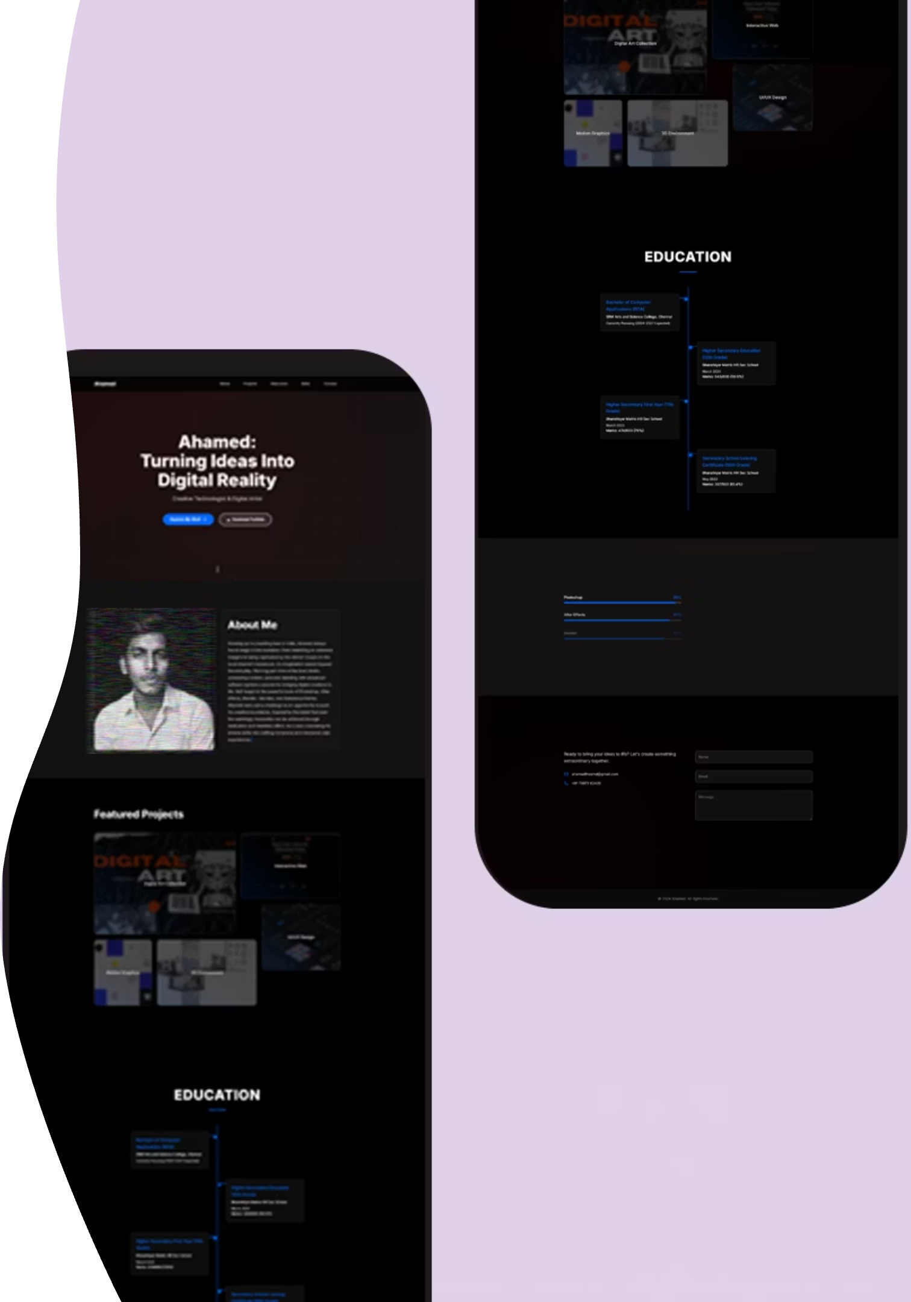
Results and Screenshots
The final project is a fully functional, aesthetically pleasing, and highly interactive portfolio website.
The website is optimized for fast loading and security.
It is compatible with all major modern browsers.
[Include screenshots of your website here, showing different sections like the hero, projects, and contact form.]

Slide 10
Conclusion
The project demonstrates expertise in modern web development practices.
It provides a complete guide for others to learn advanced web development techniques.
The portfolio is a scalable platform that can be easily maintained and updated.
GitHub Link
Project Repository: https://github.com/bagrudeen/ahamed-portfolio
Live Demo: https://bagrudeen.github.io/ahamed-portfolio/

